Slide 1
Outline
Input/Output Ports and Circuits
External Memory
Counters and Timers
Serial data Input/Output
Interrupts

Slide 2
Input/Output Pins, Ports and Circuits

Slide 3
IMPORTANT PINS (IO Ports)
One of the most useful features of the 8051 is that it contains four I/O ports (P0 - P3)
Port 0 （pins 32-39）：P0（P0.0～P0.7）
  8-bit R/W - General Purpose I/O
  Or acts as a multiplexed low byte address and data bus for external memory design
Port 1 （pins 1-8） ：P1（P1.0～P1.7）
  Only 8-bit R/W - General Purpose I/O

Slide 4
IMPORTANT PINS (IO Ports)
Port 2 （pins 21-28）：P2（P2.0～P2.7）
  8-bit R/W - General Purpose I/O
  Or high byte of the address bus for external memory design
Port 3 （pins 10-17）：P3（P3.0～P3.7）
  General Purpose I/O
  if not using any of the internal peripherals (timers) or external interrupts.
Each port can be used as input or output (bi-direction)

Slide 5
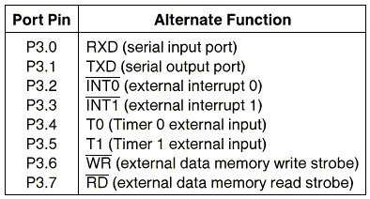
Port 3 Alternate Functions

Slide 6
External Memory

Slide 7
Types of Memory
External Code Memory (64k)
External RAM Data Memory (64k)
Internal Code Memory
  4k,8k,12k,20k
  ROM, EPROM, EEPROM
Internal RAM
  First 128 bytes:
  00h to 1Fh Register Banks
    20h to 2Fh Bit Addressable RAM
  30 to 7Fh General Purpose RAM
  Next 128 bytes:
  80h to FFh Special Function Registers

Slide 8
External Memory
/EA（pin 31）：external access
  /EA=‘0’ indicates that code is stored externally.
  /PSEN ＆ ALE are used for external ROM.
  For 8051 internal code, /EA pin is connected to Vcc.
  “/” means active low.
/PSEN（pin 29）：program store enable
  Output- connected to ROM.
  Read signal – fetch from ROM

Slide 9
External Memory
ALE（pin 30）: address latch enable
  It is an output pin and is active high
  8051 port 0 provides both address and data
  The ALE pin is used for de-multiplexing the address and data by connecting to the G pin of the 74LS373 latch.

Slide 10
Counters and Timers

Slide 11
Timers /Counters
The 8051 has 2 timers/counters: timer/counter 0 and timer/counter 1. They can be used as
The timer is used as a time delay generator.
  The clock source is the internal crystal frequency of the 8051.
An event counter.
  External input from input pin to count the number of events on registers.
  These clock pulses cold represent the number of people passing through an entrance, or the number of wheel rotations, or any other event that can be converted to pulses.

Slide 12
Registers Used in Timer/Counter
TH0, TL0, TH1, TL1
TMOD (Timer mode register)
TCON (Timer control register)
Since 8052 has 3 timers/counters, the formats of these control registers are different.
  T2CON (Timer 2 control register), TH2 and TL2 used for 8052 only.

Slide 13
Basic Registers of the Timer
Both timer 0 and timer 1 are 16 bits wide.
  These registers stores
    the time delay as a timer
    the number of events as a counter
  Timer 0: TH0 & TL0
    Timer 0 high byte, timer 0 low byte
  Timer 1: TH1 & TL1
    Timer 1 high byte, timer 1 low byte
  Each 16-bit timer can be accessed as two separate registers of low byte and high byte.

Slide 14
Timer Registers
TH0
TL0
D15
D14
D13
D12
D11
D10
D9
D8
D7
D6
D5
D4
D3
D2
D1
D0
Timer 0
TH1
TL1
D15
D14
D13
D12
D11
D10
D9
D8
D7
D6
D5
D4
D3
D2
D1
D0
Timer 1

Slide 15
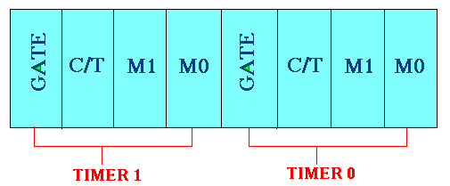
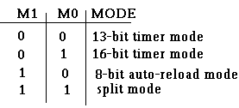
TMOD Register:
Gate : When set, timer only runs while INT(0,1) is high.
C/T : Counter/Timer select bit.
M1 : Mode bit 1.
M0 : Mode bit 0.

Slide 16
TMOD Register
GATE Gating control when set. Timer/counter is enabled only while the INTx pin is high and the TRx control pin is set. When cleared, the timer is enabled whenever the TRx control bit is set.
C/T Timer or counter selected cleared for timer operation (input from internal system clock). Set for counter operation (input from Tx input pin).
M1 Mode bit 1
M0 Mode bit 0
(MSB)
(LSB)
GATE
C/T
M1
M0
GATE
C/T
M1
M0
Timer 1
Timer 0

Slide 17
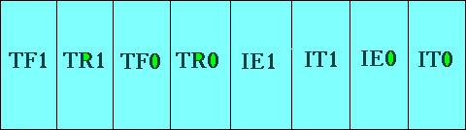
TCON Register:
TF1: Timer 1 overflow flag.
TR1: Timer 1 run control bit.
TF0: Timer 0 overflag.
TR0: Timer 0 run control bit.
IE1: External interrupt 1 edge flag.
IT1: External interrupt 1 type flag.
IE0: External interrupt 0 edge flag.
IT0: External interrupt 0 type flag.

Slide 18
Serial data Input/Output

Slide 19
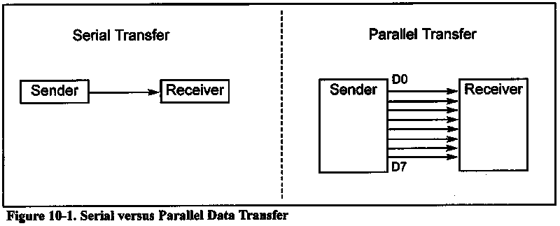
Basics of serial communication
Parallel: expensive - short distance – fast
Serial :cheaper– long (two different cities by modem)-slow

Slide 20
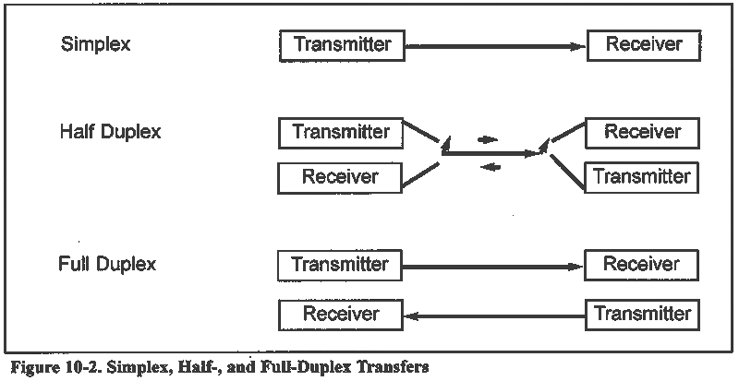
Basics of serial communication

Slide 21
How to communicate 8051 to PC
Connect TXD to RXD and RXD to TXD from pc to 8051
Use max232 to transform signal from TTL level to RS232 level
The baud rate of the 8051 must matched the baud rate of the pc
PC standard baud rate
  2400-4800-9600-14400-19200-28800-33600-57600
Serial mode 1 is used
Timer 1 is used
The 8051 UART divides the machine cycle frequency by 32
Machine cycle is 1/12 XTAL frequency
We use timer1 in mode 2 (auto reload)

Slide 22
Serial control (SCON) Register
SM0
SM1
SM2
REN
TB8
RB8
TI
RI
SM0 (SCON.7) : mode specifier
SM1 (SCON.6) : mode specifier
SM2 (SCON.5) : used for multi processor communication
REN (SCON.4) : receive enable (by software enable/disable)
TB8 (SCON.3) : transmit bit8
RB8 (SCON.2) : receive bit 8
TI (SCON.1) : transmit interrupt flag set by HW clear by SW
RI (SCON.0) : receive interrupt flag set by HW clear by SW

Slide 23
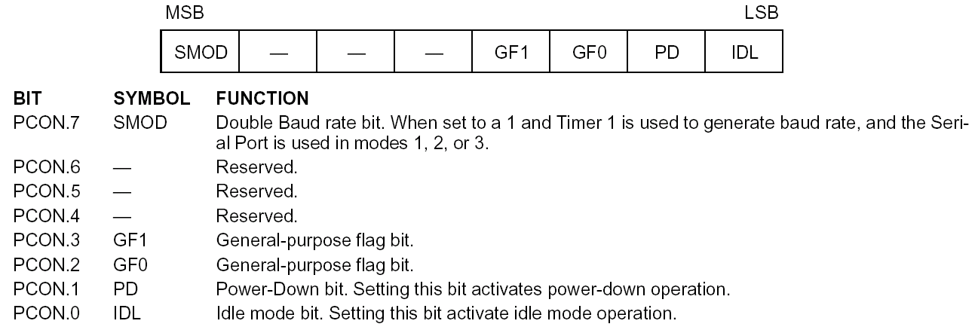
Power control register

Slide 24
Interrupts

Slide 25
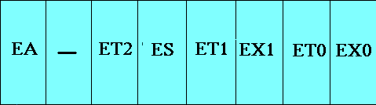
Interrupt Enable Register :
EA : Global enable/disable.
--- : Undefined.
ET2 :Enable Timer 2 interrupt.
ES :Enable Serial port interrupt.
ET1 :Enable Timer 1 interrupt.
EX1 :Enable External 1 interrupt.
ET0 : Enable Timer 0 interrupt.
EX0 : Enable External 0 interrupt.

Slide 26
Interrupt Priorities (IP) Register
---
---
PT2
PS
PT1
PX1
PT0
PX0
IP.7: reserved
IP.6: reserved
IP.5: timer 2 interrupt priority bit(8052 only)
IP.4: serial port interrupt priority bit
IP.3: timer 1 interrupt priority bit
IP.2: external interrupt 1 priority bit
IP.1: timer 0 interrupt priority bit
IP.0: external interrupt 0 priority bit

